Slide 1
Introduction to image analysis
Adam Tyson
October 2018

Slide 2
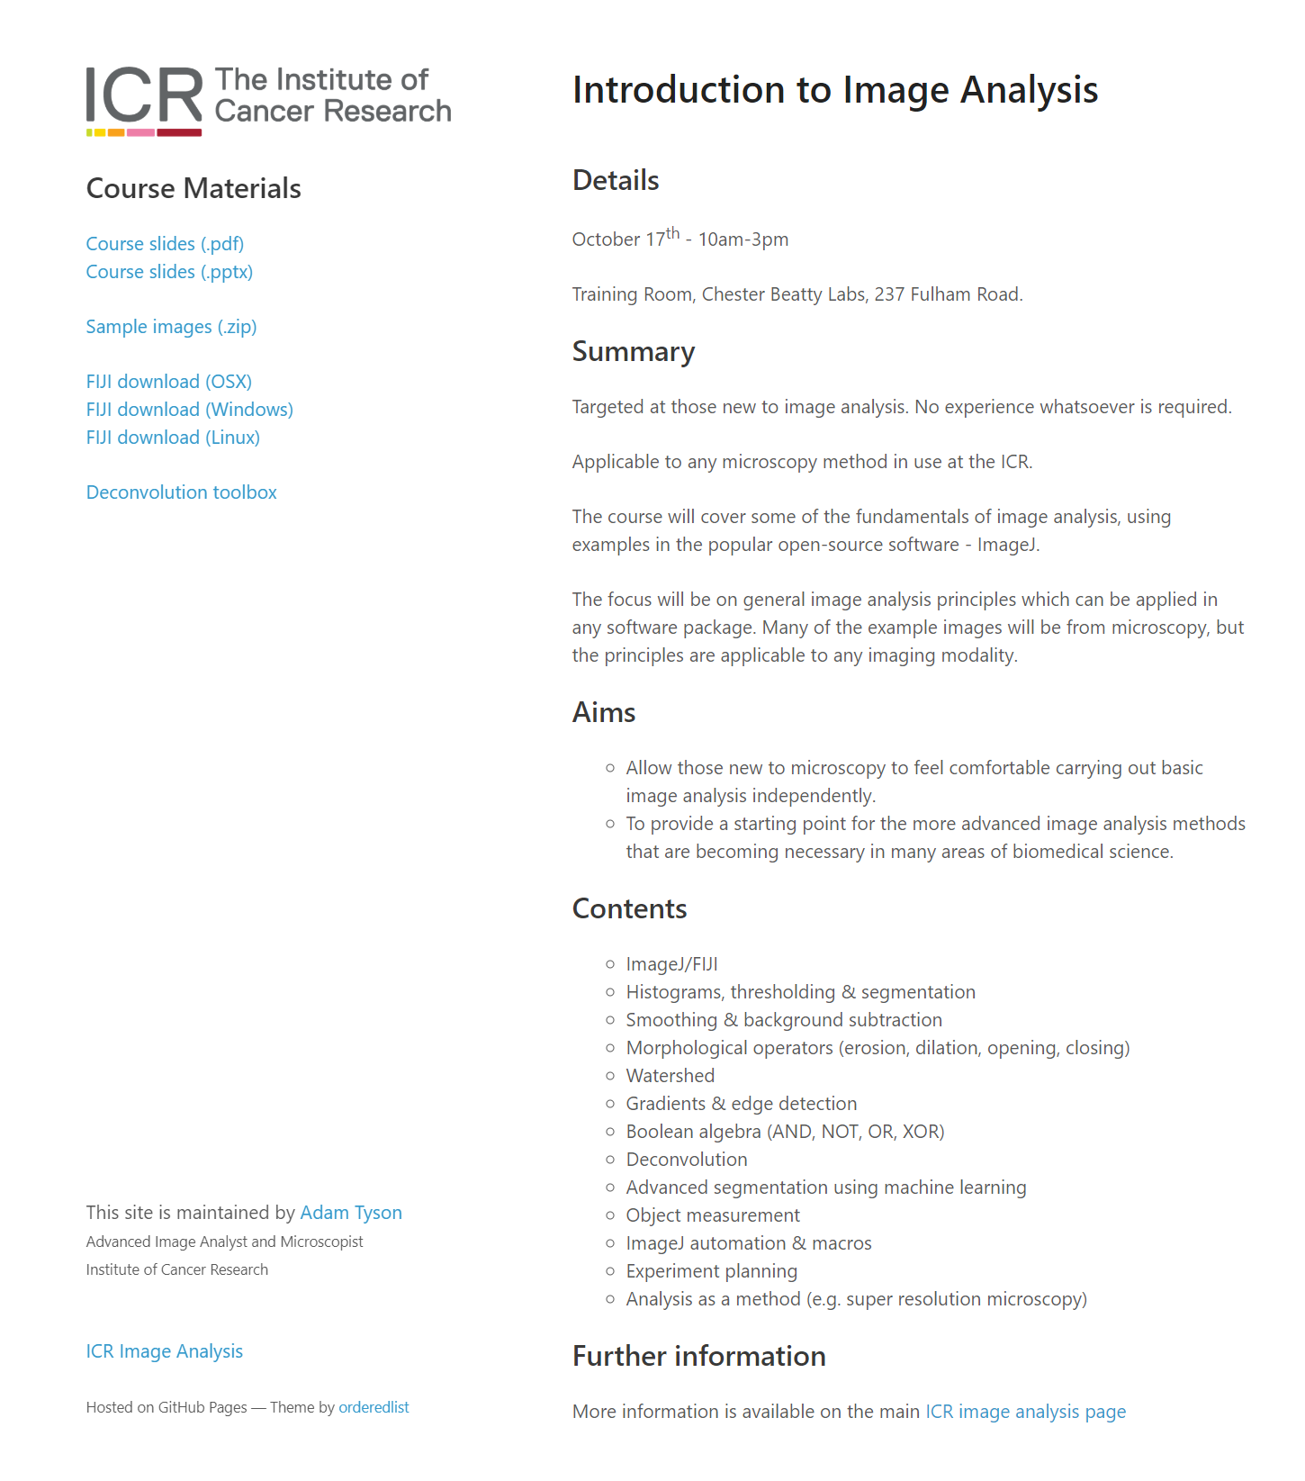
Course website
bit.ly/ICR-image
Slides
Sample images
Software
More information on main ICR image analysis website
icr-analysis.github.io

Slide 3
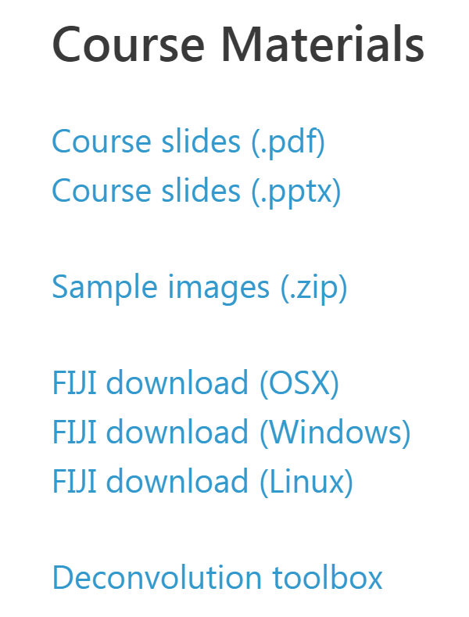
Course website - download

Slide 4
Aims
Introduction to fundamental image analysis principles
Using ImageJ/FIJI (but everything is general)
Convert biological question into computational problem

Slide 5
Aims
Introduction to fundamental image analysis principles
Using ImageJ/FIJI (but everything is general)
Convert biological question into computational problem
Disclaimer:
Some parts may be obvious, bear with me.
The focus is on understanding image analysis, not pressing buttons.
Like anything, requires practice.

Slide 6
Aims
Introduction to fundamental image analysis principles
Using ImageJ/FIJI (but everything is general)
Convert biological question into computational problem
Disclaimer:
Some parts may be obvious, bear with me.
The focus is on understanding image analysis, not pressing buttons.
Like anything, requires practice.
Email me whenever – adam.tyson@icr.ac.uk

Slide 7
Questions

Slide 8
Questions
Are you currently using microscopy or planning to?

Slide 9
Questions
Are you currently using microscopy or planning to?
Which system(s)?
Confocal/spinning disk
Multiphoton
High content (Celigo/Operetta/ImageXpress)
TIRF
Lightsheet
Any others?

Slide 10
Questions
Are you currently using microscopy or planning to?
Which system(s)?
Confocal/spinning disk
Multiphoton
High content (Celigo/Operetta/ImageXpress)
TIRF
Lightsheet
Any others?
Which analysis software?

Slide 11
Questions
Are you currently using microscopy or planning to?
Which system(s)?
Confocal/spinning disk
Multiphoton
High content (Celigo/Operetta/ImageXpress)
TIRF
Lightsheet
Any others?
Which analysis software?
A bit / no / lots of experience?

Slide 12
Questions
Are you currently using microscopy or planning to?
Which system(s)?
Confocal/spinning disk
Multiphoton
High content (Celigo/Operetta/ImageXpress)
TIRF
Lightsheet
Any others?
Which analysis software?
A bit / no / lots of experience?
Any specific aims?

Slide 13
First (and most important lesson)
Sample
preparation
Test your analysis before you acquire data!
Data
Analysis
Biological information

Slide 14
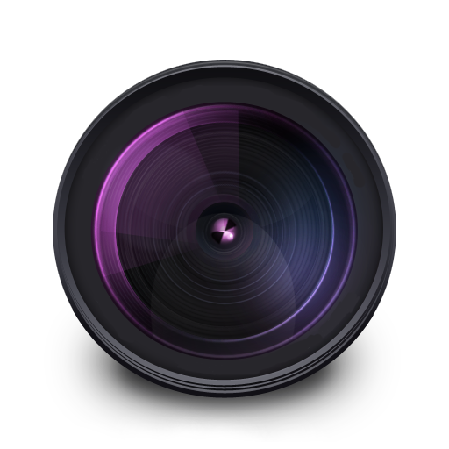
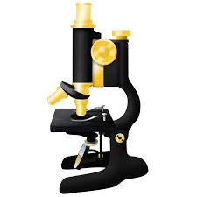






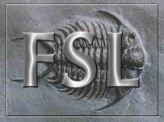



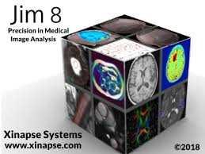






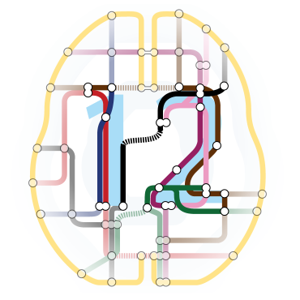
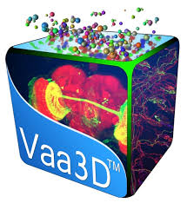
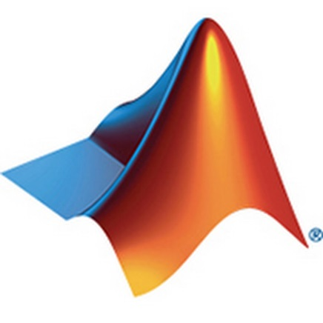


Software

Slide 15
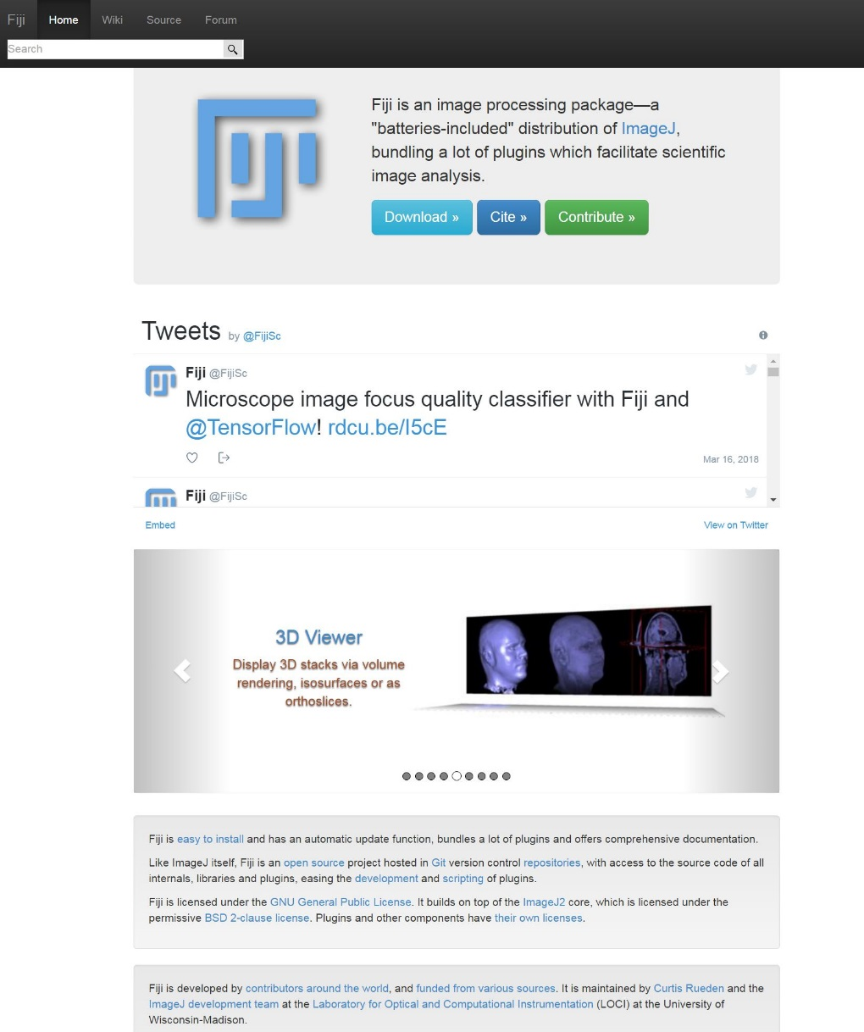
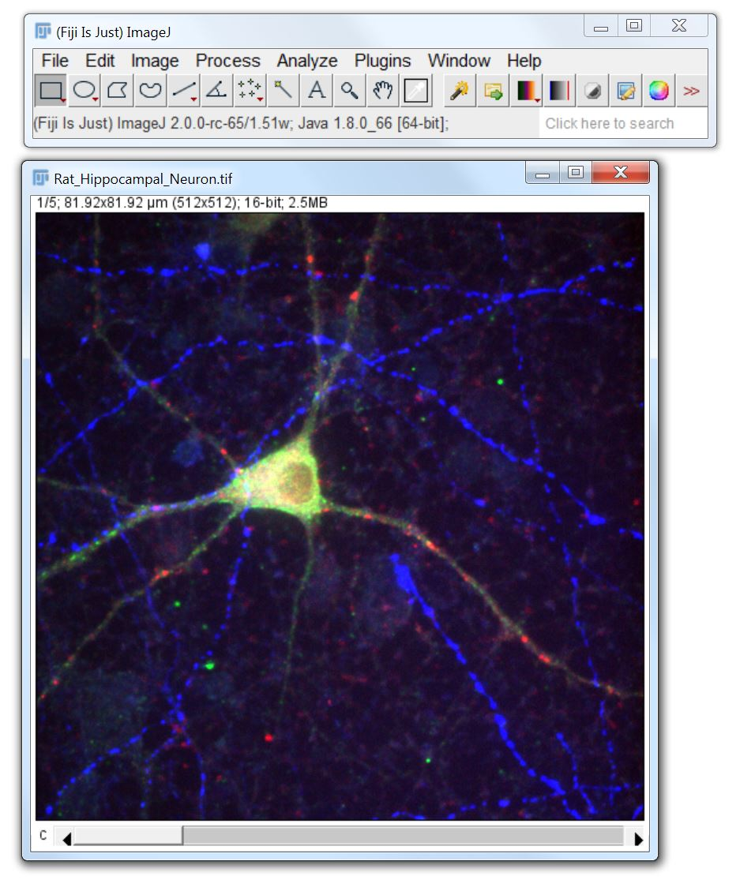
FIJI (FIJI is just ImageJ)
https://fiji.sc/
http://forum.imagej.net/

Slide 16
FIJI (FIJI is just ImageJ)
ImageJ with lots preinstalled
https://fiji.sc/
http://forum.imagej.net/

Slide 17
FIJI (FIJI is just ImageJ)
Free
Open source
Cross platform
Flexible
Huge community
https://fiji.sc/
http://forum.imagej.net/

Slide 18
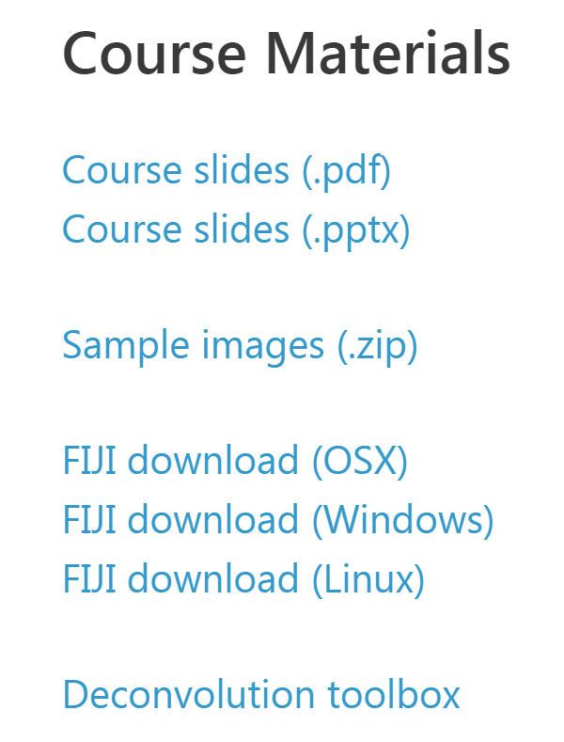
FIJI - installation
Download
Windows
Open fiji-win64.zip in “windows explorer” & click “extract all files” to e.g. Desktop
Linux (e.g. Ubuntu)
Open fiji-linux64.zip with “archive manager” & extract to e.g. Desktop
Mac (OSX)
Open fiji-macosx.dmg, drag and drop Fiji.app to applications (or anywhere else).
May need to go to “System Preferences > Security & Privacy” and allow unidentified developers.

Slide 19
Why computational image analysis?

Slide 20
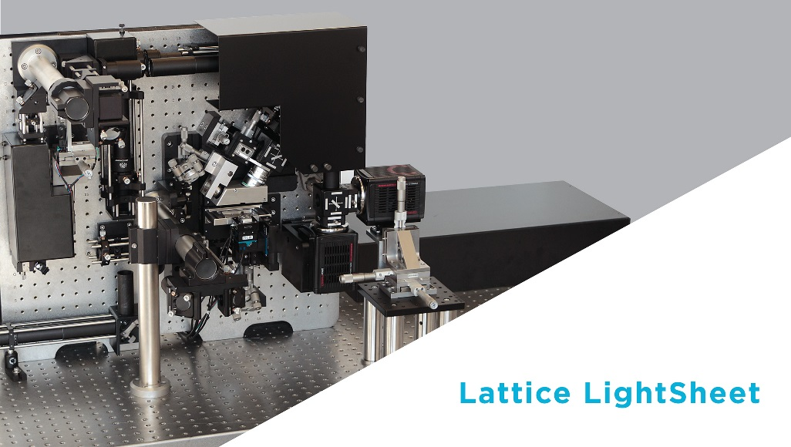
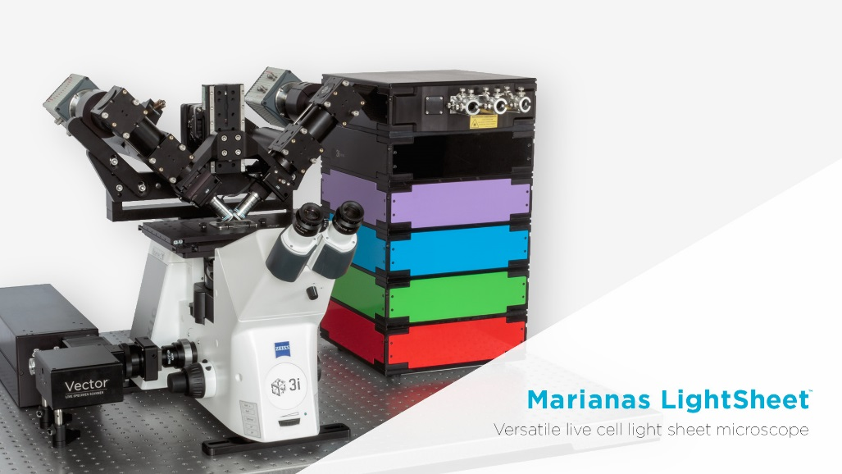
Why computational image analysis?
Quantity of data (TB’s per day)

Slide 21
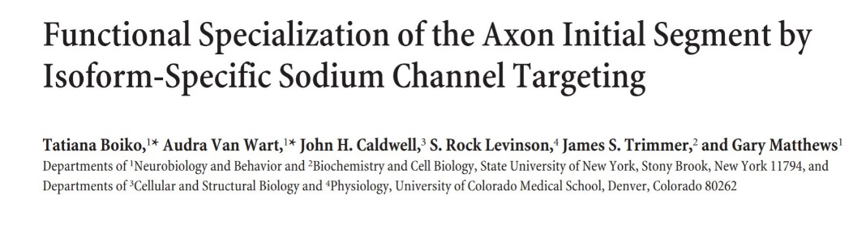
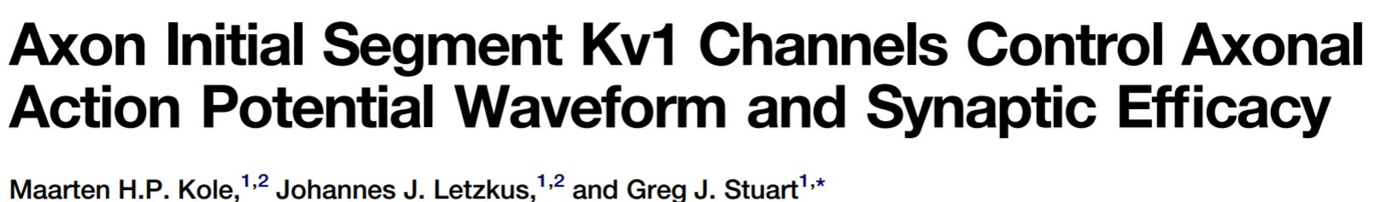
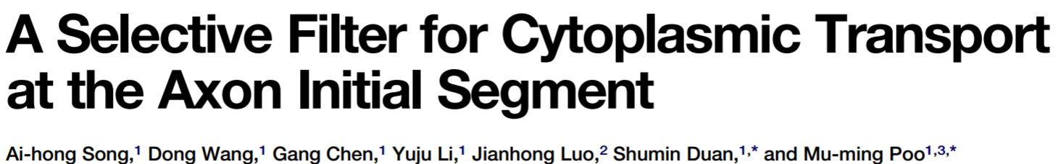
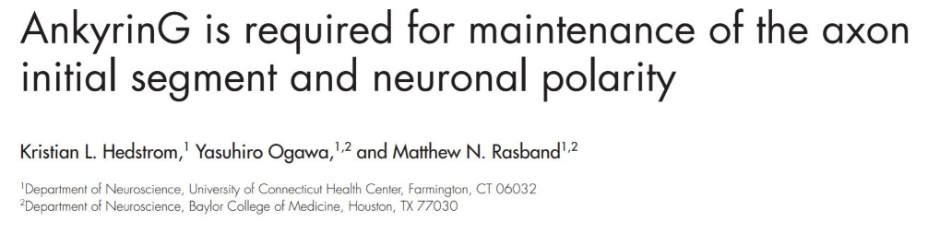
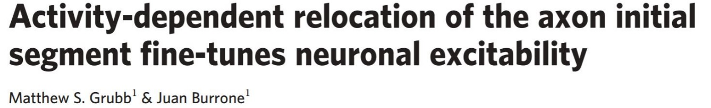
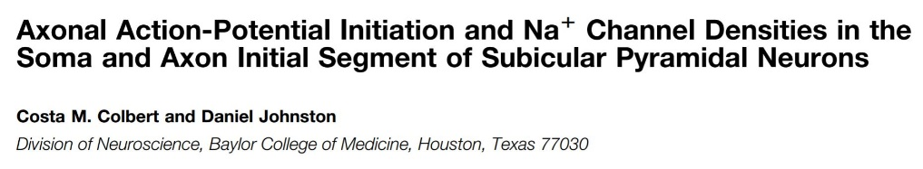
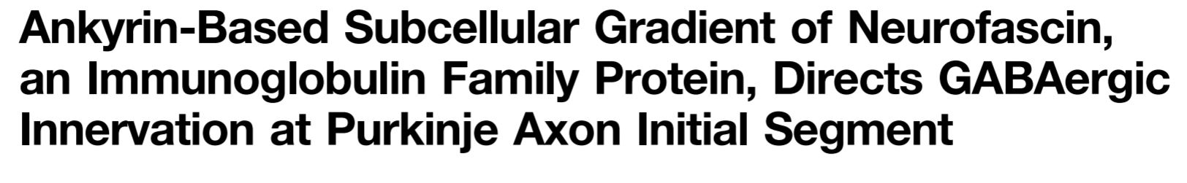
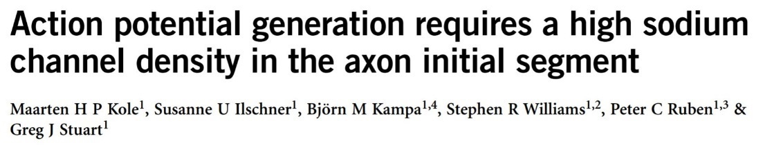
Why computational image analysis?
Quantity of data (TB’s per day)
Reproducibility, comparison

Slide 22
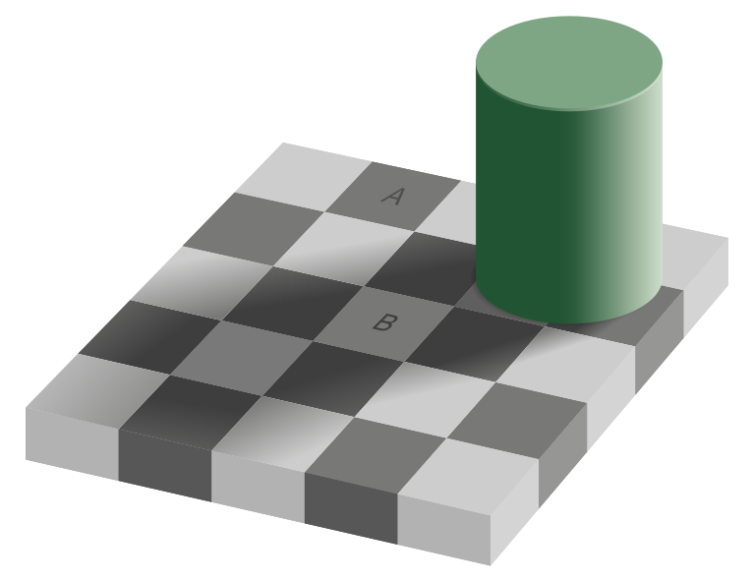
Why computational image analysis?
Visual system relies heavily on context and relative changes.
Checker shadow illusion, Edward Adelson 1995.

Slide 23

Why computational image analysis?
Visual system relies heavily on context and relative changes.
Checker shadow illusion, Edward Adelson 1995.

Slide 24

Why computational image analysis?
Visual system relies heavily on context and relative changes.
Checker shadow illusion, Edward Adelson 1995.
Jastrow illusion, Joseph Jastrow (and others), 1892.

Slide 25
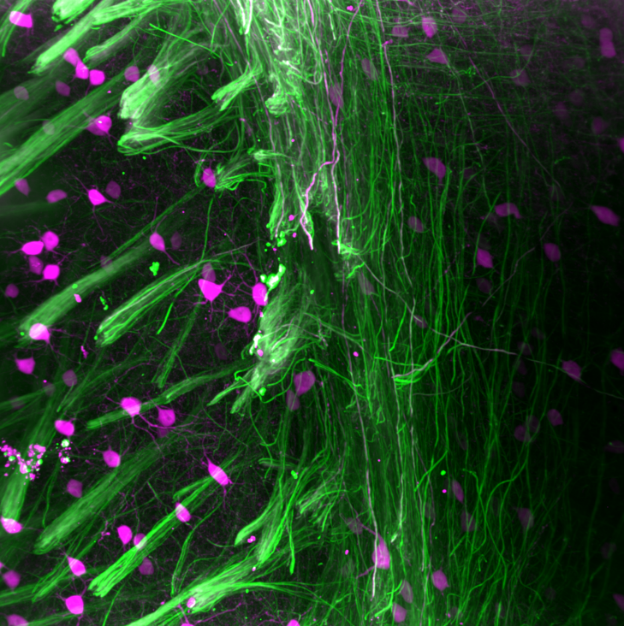
Nearly all microscopy images aren’t colour

Slide 26
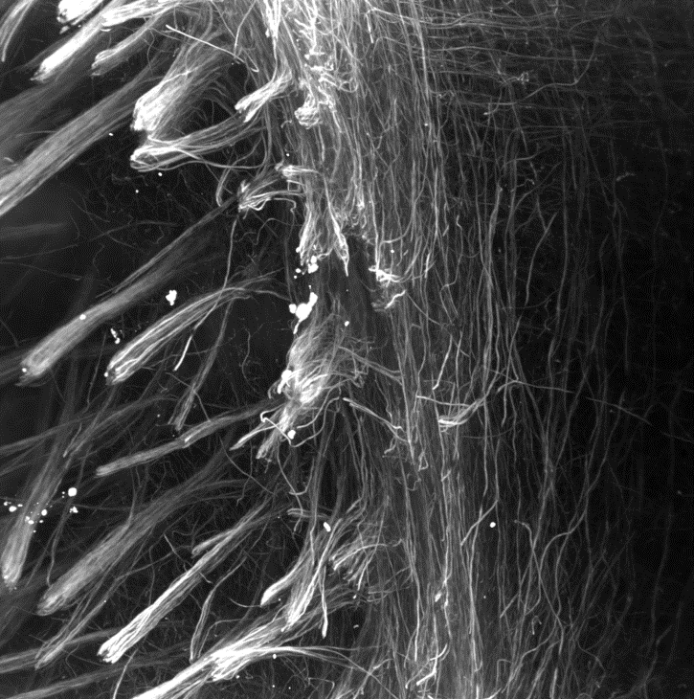
Nearly all microscopy images aren’t colour

Slide 27
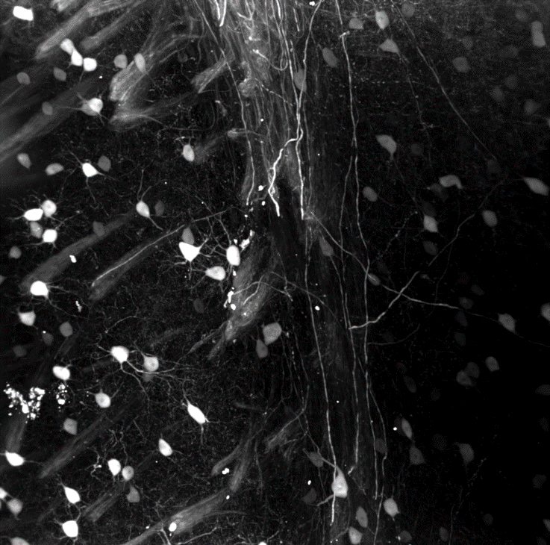
Nearly all microscopy images aren’t colour

Slide 28

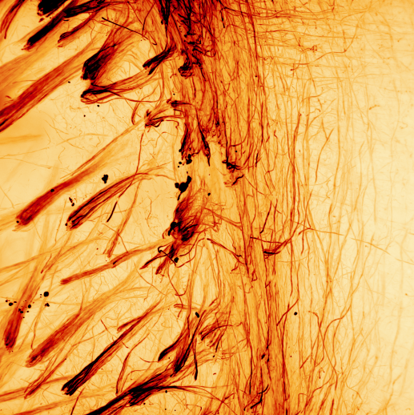
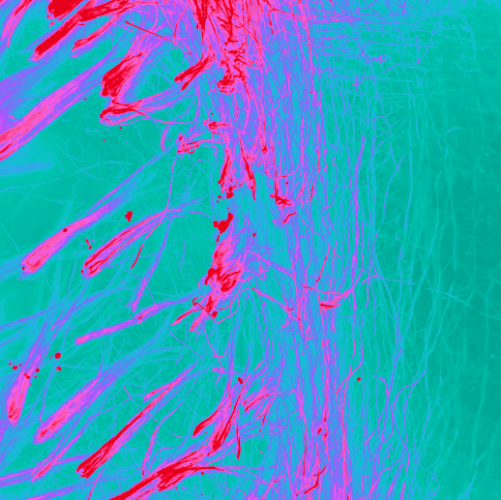
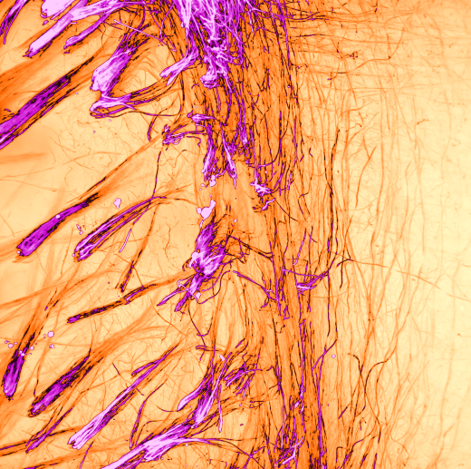
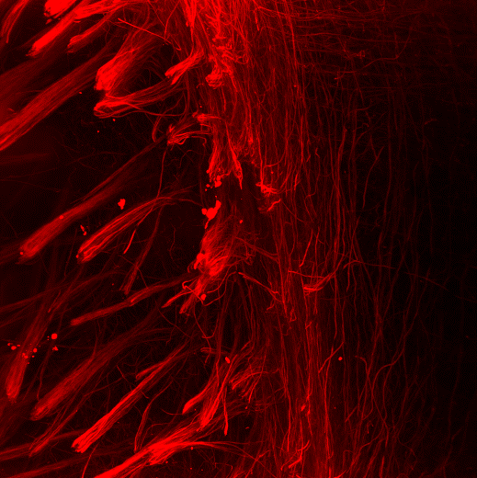
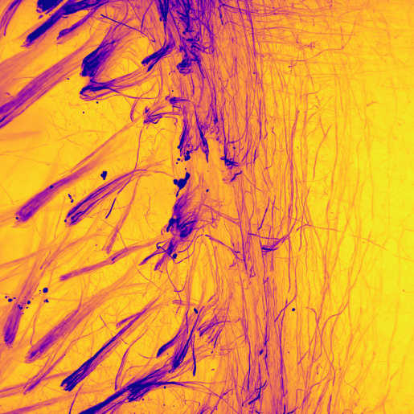
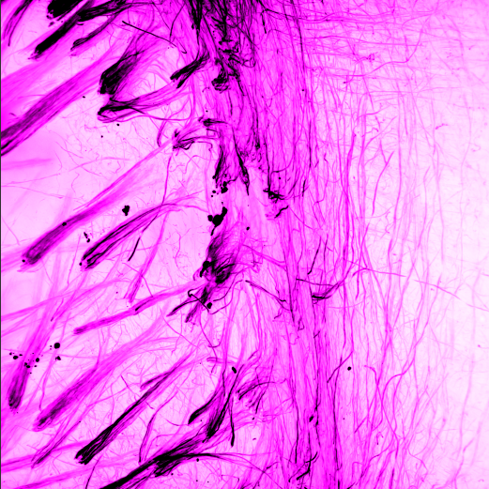
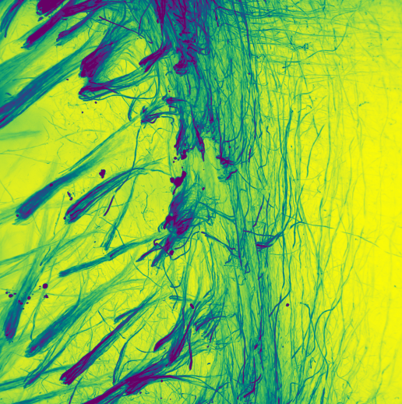
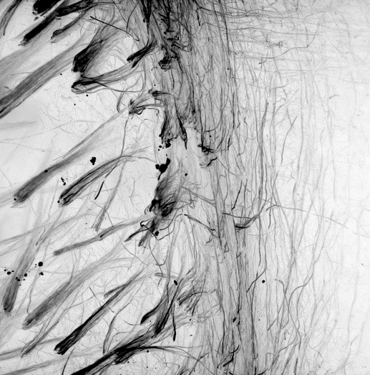
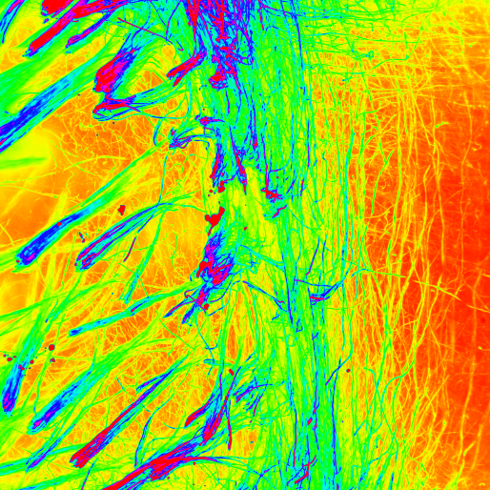
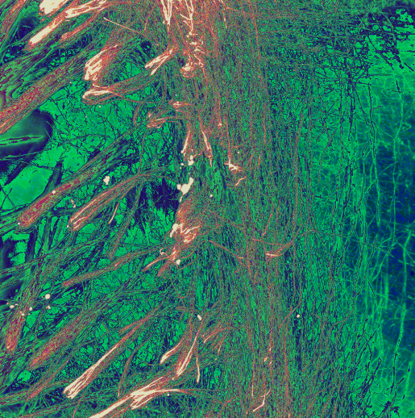
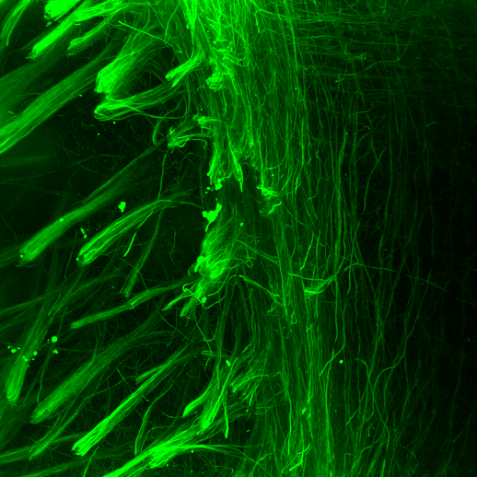
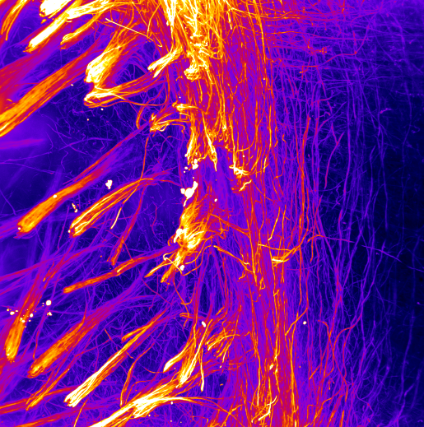
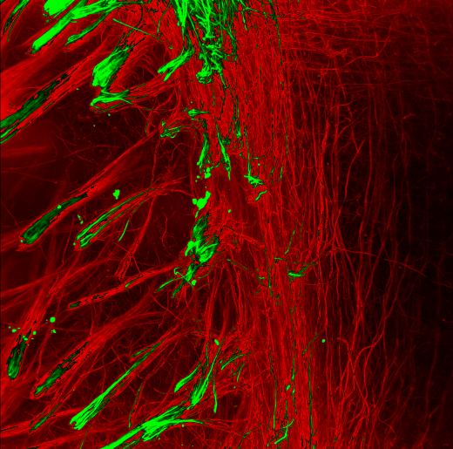
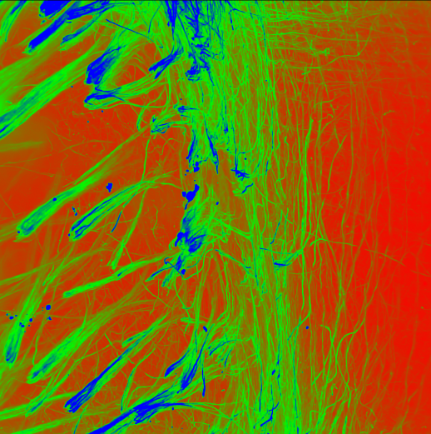
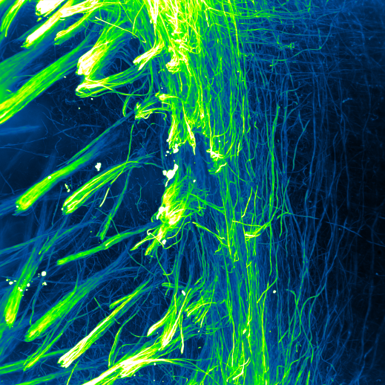
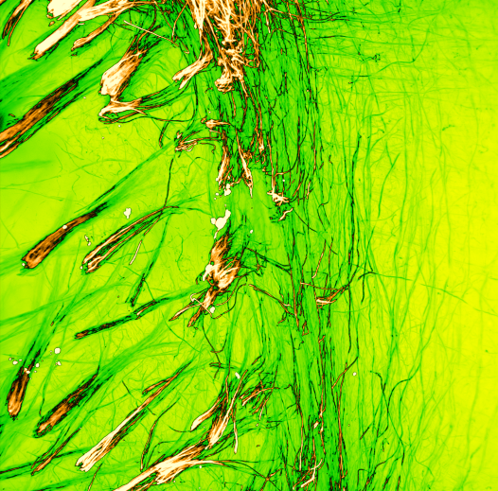
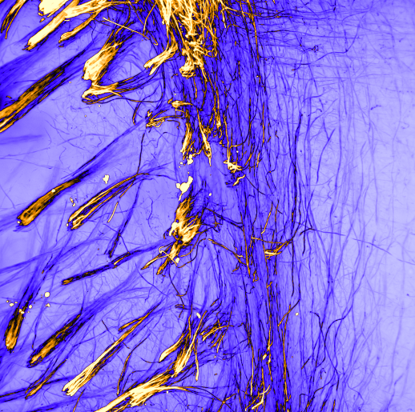
Lookup tables (LUTs)

Slide 29
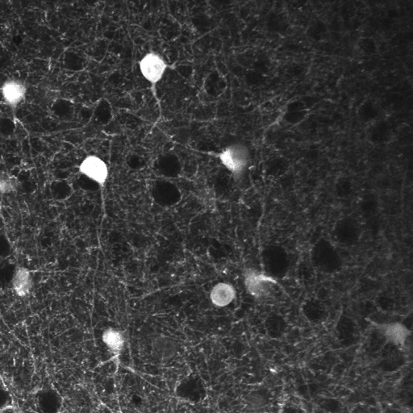
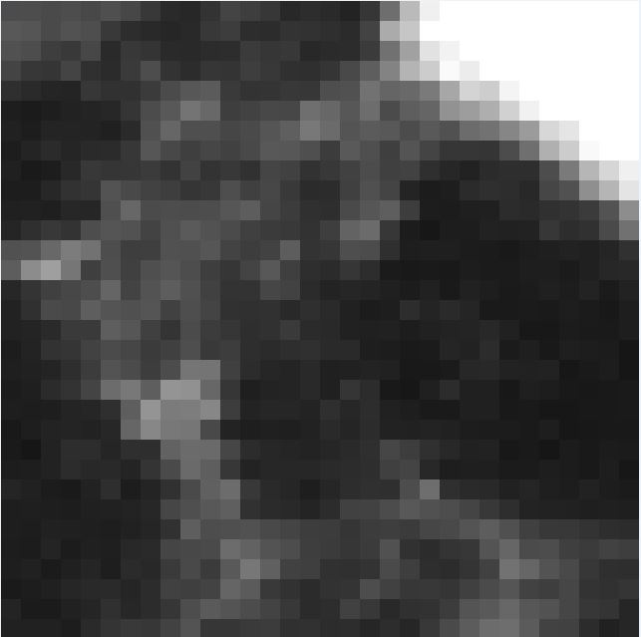

Images are arrays of numbers
78 | 64 | 71 | 57 | 43 | 44
86 | 93 | 69 | 60 | 48 | 46
75 | 64 | 57 | 59 | 55 | 62
70 | 65 | 69 | 85 | 56 | 54
54 | 68 | 88 | 63 | 46 | 43
51 | 51 | 74 | 66 | 43 | 35

Slide 30
More complicated images are still arrays of numbers
2D
78 | 64 | 71 | 57 | 43 | 44
86 | 93 | 69 | 60 | 48 | 46
75 | 64 | 57 | 59 | 55 | 62
70 | 65 | 69 | 85 | 56 | 54
54 | 68 | 88 | 63 | 46 | 43
51 | 51 | 74 | 66 | 43 | 35

Slide 31
More complicated images are still arrays of numbers
2D

Slide 32
More complicated images are still arrays of numbers
RGB
2D

Slide 33
More complicated images are still arrays of numbers
RGB
2D
3D
Notes:
.

Slide 34
More complicated images are still arrays of numbers
RGB
2D
Time-lapse
3D

Slide 35
More complicated images are still arrays of numbers
RGB
2D
Time-lapse
3D RGB
3D

Slide 36
More complicated images are still arrays of numbers
RGB
2D
Time-lapse
3D RGB
3D
3D time-lapse

Slide 37
More complicated images are still arrays of numbers
RGB
2D
Time-lapse
3D RGB
3D
3D time-lapse
3D RGB time-lapse

Slide 38
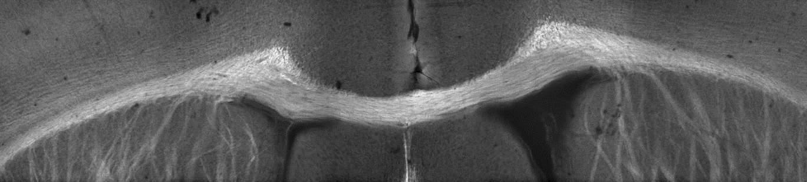
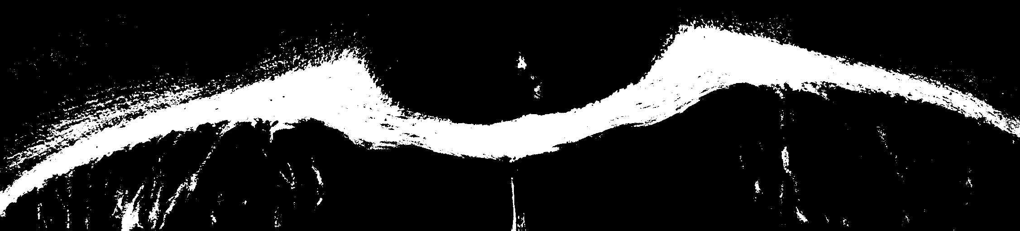

Image processing vs analysis

Slide 39
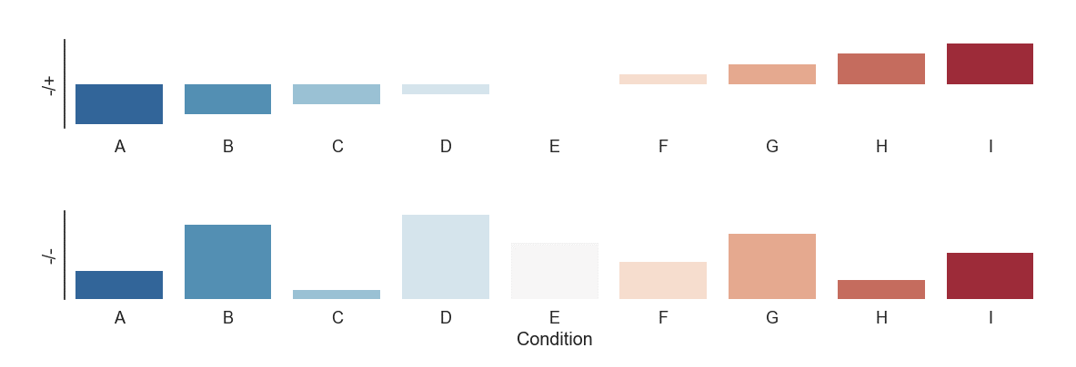
Image processing vs analysis
Volume
Shape
Texture

Slide 40
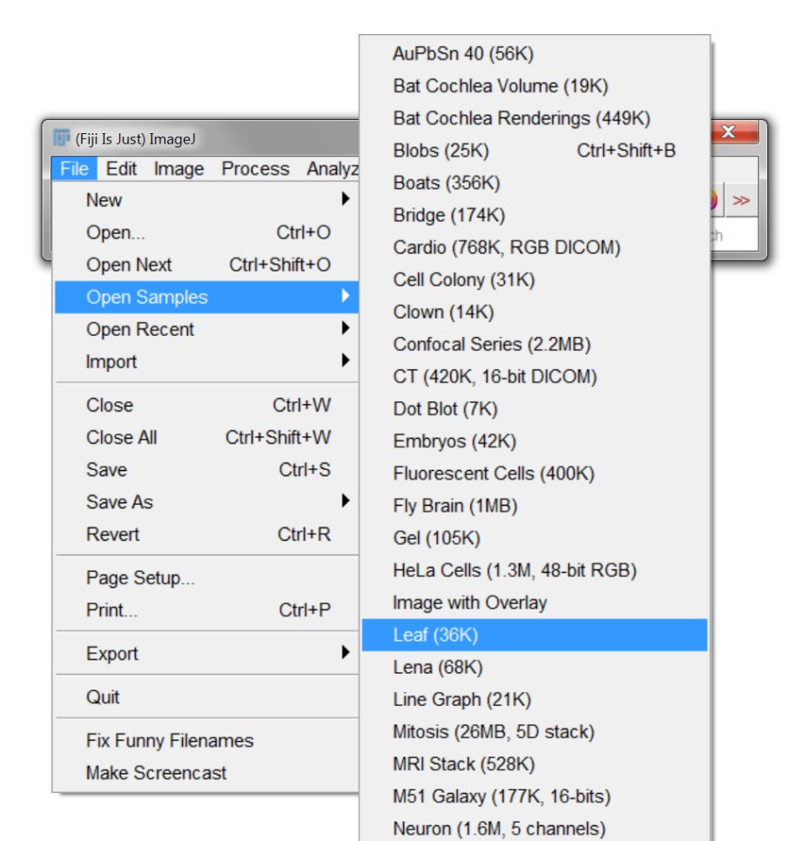
Histogram
Open any sample image

Slide 41
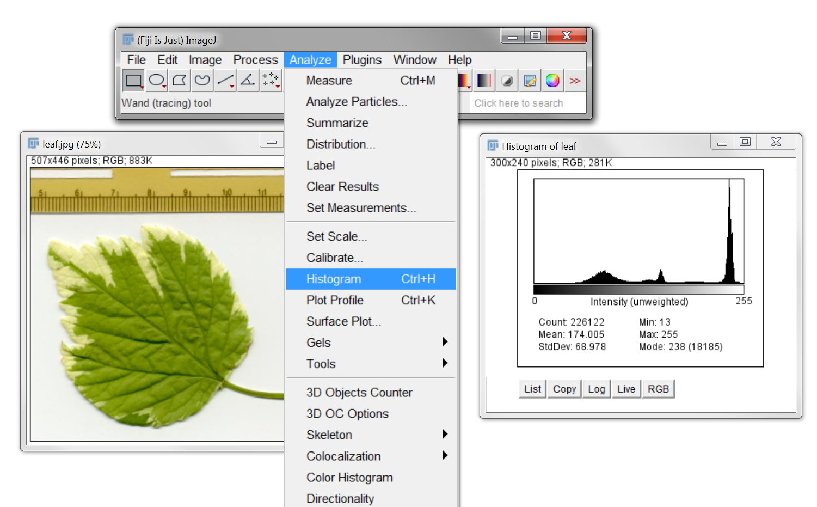

Histogram
Open any sample image
Open histogram
N.B. – On OSX, tabs are in the menu bar

Slide 42

Thresholding
Threshold (κ)

Slide 43


Thresholding
$$k$$

Slide 44


Thresholding
$$k$$
$$k$$

Slide 45


Thresholding
$$k$$
$$k$$
$$k$$

Slide 46

Thresholding – try it out
Open DAPI.tif (can drag and drop)

Slide 47

Thresholding – try it out
Open DAPI.tif (can drag and drop)
Threshold

Slide 48

Manual threshold - problems
DAPI.tif

Slide 49

Manual threshold - problems
DAPI.tif
DAPI_2.tif

Slide 50

Automatic thresholding – Equal masses
Ideal case
$$k$$

Slide 51


Automatic thresholding – Equal masses
Ideal case
Real case
$$k$$
$$k$$

Slide 52




Automatic thresholding – Otsu’s method
Minimise within class variance (σ_{W})
Maximise between class variance (σ_{B})
$$k$$
Otsu (1979) IEEE Transactions on Systems, Man and Cybernetics. Vol SMC-9, No 1, p62

Slide 53
Automatic thresholding – Otsu’s method
Minimise within class variance (σ_{W})
Maximise between class variance (σ_{B})
$$k$$
Otsu (1979) IEEE Transactions on Systems, Man and Cybernetics. Vol SMC-9, No 1, p62

Slide 54

Automatic thresholding – Otsu’s method
Minimise within class variance (σ_{W})
Maximise between class variance (σ_{B})
$$k$$
$$k$$
Otsu (1979) IEEE Transactions on Systems, Man and Cybernetics. Vol SMC-9, No 1, p62

Slide 55
Unimodal thresholding – Rosin’s method
Use shape of distribution to find threshold
Rosin (2001) Pattern Recognition. Vol 34, No 11, p2083

Slide 56

Unimodal thresholding – Rosin’s method
Use shape of distribution to find threshold
$$k$$
Rosin (2001) Pattern Recognition. Vol 34, No 11, p2083

Slide 57

Try it out – Otsu’s method
Otsu (1979) IEEE Transactions on Systems, Man and Cybernetics. Vol SMC-9, No 1, p62

Slide 58

Many, many other methods
Kapur et al. (1985) Graphical Models and Image Processing Vol 29, No 3, p273

Slide 59


Not always that simple …
Open DAPI_3.tif
Pick a threshold
vs

Slide 60

Background subtraction – e.g. vignetting
Sample

Slide 61
Background subtraction – e.g. vignetting
Sample
Microscope

Slide 62

Background subtraction – e.g. vignetting
Sample
Microscope
Image

Slide 63
Background subtraction – e.g. vignetting

Slide 64
Background subtraction – e.g. vignetting

Slide 65
Background subtraction – e.g. vignetting

Slide 66
Background subtraction – e.g. vignetting
How to calculate??

Slide 67
Estimate background – Gaussian smoothing
Seems arbitrary, but smoothing is often a key step in image processing

Slide 68

Estimate background – Gaussian smoothing
Seems arbitrary, but smoothing is often a key step in image processing

Slide 69
Estimate background – Gaussian smoothing
Seems arbitrary, but smoothing is often a key step in image processing
Try a value of 200 pixels

Slide 70

Estimate background – Gaussian smoothing
May need to adjust brightness

Slide 71

Estimate background – Gaussian smoothing
May need to adjust brightness

Slide 72


Estimate background
(Open a new DAPI_3.tif)

Slide 73

Estimate background
(Open a new DAPI_3.tif)

Slide 74

Now try thresholding

Slide 75


Now try thresholding
Better, but not great

Slide 76

Morphological operations
Processing of (usually binary) images based on shape

Slide 77

Morphological operations
Try on the previous example
Thresholded

Slide 78

Morphological operations
Try on the previous example
Thresholded
Eroded

Slide 79

Morphological operations
Try on the previous example
Dilated and closed
Thresholded
Eroded

Slide 80

Watershed – separate objects
From the previous example
Notes:
Basic implementation in ImageJ – but often requires a lot of tweaking if you don’t have two perfectly circular objects.

Slide 81

Watershed – separate objects
From the previous example

Slide 82

Watershed – separate objects
From the previous example

Slide 83

Watershed

Slide 84

Watershed

Slide 85
Watershed

Slide 86
Watershed
Negative intensity profile
Distance transform

Slide 87
Watershed
Negative intensity profile
Distance transform

Slide 88
Watershed
Negative intensity profile
Distance transform

Slide 89
Watershed
Negative intensity profile
Distance transform

Slide 90
Watershed
Negative intensity profile
Distance transform

Slide 91
Watershed
Negative intensity profile
Distance transform
Watershed

Slide 92



Filters - Gaussian
Large kernel (200 pix)
Correct inhomogeneous illumination

Slide 93


Filters - Gaussian
Small kernel (8 pix)
Smooth intensity variations for thresholding

Slide 94


Filters - Gaussian
Open foci.tif & try thresholding (to segment whole nuclei)
Apply Gaussian smoothing (use preview) & try again

Slide 95

Filters - Gaussian
Open foci.tif & try thresholding
Apply Gaussian smoothing (use preview) & try again
vs

Slide 96


Filters - Gradient
Edge detection

Slide 97
Filters - Gradient
Edge detection
Approximate derivative:
The Sobel operator

Slide 98

Filters - Gradient
Edge detection
Approximate derivative:
The Sobel operator

Slide 99

Filters - Gradient
Edge detection
Approximate derivative:
The Sobel operator

Slide 100

Filters - Gradient

Slide 101









Filters - Gradient

Slide 102

Filters - Gradient
Combine

Slide 103

Filters - Gradient
Combine

Slide 104
Boolean image mathematics

Slide 105
Boolean image mathematics
AND

Slide 106
Boolean image mathematics
AND
OR

Slide 107
Boolean image mathematics
AND
OR
XOR

Slide 108


Boolean image mathematics - masking

Slide 109


Boolean image mathematics - masking
PV.tif
PV_DAPI.tif

Slide 110
Boolean image mathematics - masking
PV.tif
PV_DAPI.tif
PV_seg.tif

Slide 111

Boolean image mathematics - masking
PV.tif
PV_DAPI.tif
PV_seg.tif

Slide 112
First (and most important lesson) – again!
Sample
preparation
Test your analysis before you acquire data!
Data
Analysis
Biological information

Slide 113
Deconvolution
Sample

Slide 114
Deconvolution
Sample
PSF

Slide 115
Deconvolution
Sample
Blurred
PSF

Slide 116
Deconvolution
Sample
Blurred
PSF
Noise

Slide 117
Deconvolution
Sample
Blurred
Blurred & noisy
PSF
Noise

Slide 118
Deconvolution
Sample
Blurred
Blurred & noisy
PSF
Noise
?

Slide 119
Deconvolution – how?
Constrained iterative deconvolution
e.g. Richardson-Lucy
Lucy (1974) The Astronomical Journal. Vol 79, No 6 p745
Richardson (1972) Journal of the Optical Society of America, Vol 62, No 1, p55

Slide 120
Deconvolution – how?
Image
Constrained iterative deconvolution
e.g. Richardson-Lucy
Operation
Raw Image
Lucy (1974) The Astronomical Journal. Vol 79, No 6 p745
Richardson (1972) Journal of the Optical Society of America, Vol 62, No 1, p55

Slide 121
Deconvolution – how?
Image
Constrained iterative deconvolution
e.g. Richardson-Lucy
Operation
Raw Image
Estimate
Lucy (1974) The Astronomical Journal. Vol 79, No 6 p745
Richardson (1972) Journal of the Optical Society of America, Vol 62, No 1, p55

Slide 122
Deconvolution – how?
PSF
Image
Constrained iterative deconvolution
e.g. Richardson-Lucy
Operation
Convolve with PSF
Raw Image
Estimate
Lucy (1974) The Astronomical Journal. Vol 79, No 6 p745
Richardson (1972) Journal of the Optical Society of America, Vol 62, No 1, p55

Slide 123
Deconvolution – how?
PSF
Image
Constrained iterative deconvolution
e.g. Richardson-Lucy
Operation
Convolve with PSF
Convolved
estimate
Raw Image
Estimate
Lucy (1974) The Astronomical Journal. Vol 79, No 6 p745
Richardson (1972) Journal of the Optical Society of America, Vol 62, No 1, p55

Slide 124
Deconvolution – how?
PSF
Image
Constrained iterative deconvolution
e.g. Richardson-Lucy
Operation
Convolve with PSF
Convolved
estimate
Raw Image
Estimate
Compare with raw
Raw Image
Lucy (1974) The Astronomical Journal. Vol 79, No 6 p745
Richardson (1972) Journal of the Optical Society of America, Vol 62, No 1, p55

Slide 125
Deconvolution – how?
PSF
Image
Constrained iterative deconvolution
e.g. Richardson-Lucy
Operation
Convolve with PSF
Convolved
estimate
Raw Image
Estimate
Compare with raw
Improve estimate
Raw Image
Lucy (1974) The Astronomical Journal. Vol 79, No 6 p745
Richardson (1972) Journal of the Optical Society of America, Vol 62, No 1, p55

Slide 126
Deconvolution – how?
PSF
Image
Constrained iterative deconvolution
e.g. Richardson-Lucy
Operation
Convolve with PSF
Convolved
estimate
Raw Image
Estimate
Deconvolved
Compare with raw
Improve estimate
Raw Image
Lucy (1974) The Astronomical Journal. Vol 79, No 6 p745
Richardson (1972) Journal of the Optical Society of America, Vol 62, No 1, p55

Slide 127

Deconvolution – try it out
DeconvolutionLab2
Sage et al. (2017) Methods. Vol 115, p28
http://bigwww.epfl.ch/deconvolution/deconvolutionlab2/

Slide 128
Deconvolution – BUT
Not installed with ImageJ/FIJI

Slide 129

Installing plugins
Easy way:

Slide 130

Installing plugins
Hard way:
Download .jar file and copy into plugins folder
On OSX – right click > “Show package contents”
Sage et al. (2017) Methods. Vol 115, p28
http://bigwww.epfl.ch/deconvolution/deconvolutionlab2/

Slide 131

Deconvolution – try it out
DeconvolutionLab2
Sage et al. (2017) Methods. Vol 115, p28
http://bigwww.epfl.ch/deconvolution/deconvolutionlab2/

Slide 132
Deconvolution – try it out
DeconvolutionLab2
Drag and drop
CElegans-FITC.tif
PSF-CElegans-FITC.tif
C. Elegans embryo - microtubules
Sage et al. (2017) Methods. Vol 115, p28
http://bigwww.epfl.ch/deconvolution/deconvolutionlab2/

Slide 133

Deconvolution – try it out
DeconvolutionLab2
Drag and drop
CElegans-FITC.tif
PSF-CElegans-FITC.tif
C. Elegans embryo - microtubules
Sage et al. (2017) Methods. Vol 115, p28
http://bigwww.epfl.ch/deconvolution/deconvolutionlab2/

Slide 134
Deconvolution – try it out (hopefully)
Deconvolution is computationally intense – may be very slow on these machines
http://bigwww.epfl.ch/deconvolution/deconvolutionlab2/

Slide 135

Deconvolution – try it out (hopefully)
Deconvolution is computationally intense – may be very slow on these machines
Try “Regularized Inverse Filter”
http://bigwww.epfl.ch/deconvolution/deconvolutionlab2/

Slide 136

Deconvolution – try it out (hopefully)
Deconvolution is computationally intense – may be very slow on these machines
Try “Regularized Inverse Filter”
http://bigwww.epfl.ch/deconvolution/deconvolutionlab2/

Slide 137
Deconvolution – try it out (hopefully)
Deconvolution is computationally intense – may be very slow on these machines
Try “Regularized Inverse Filter”
Richardson-Lucy – start with 10 iterations - compare
http://bigwww.epfl.ch/deconvolution/deconvolutionlab2/

Slide 138
Deconvolution – notes

Slide 139
Deconvolution – notes
GIGA – Garbage In, Garbage Out

Slide 140
Deconvolution – notes
GIGA – Garbage In, Garbage Out
Not always necessary

Slide 141
Deconvolution – notes
GIGA – Garbage In, Garbage Out
Not always necessary
Only an estimate of fluorophore distribution

Slide 142
Deconvolution – notes
GIGA – Garbage In, Garbage Out
Not always necessary
Only an estimate of fluorophore distribution
100’s of algorithms and options – try them out

Slide 143
Deconvolution – notes
GIGA – Garbage In, Garbage Out
Not always necessary
Only an estimate of fluorophore distribution
100’s of algorithms and options – try them out
Can be very slow

Slide 144
Deconvolution – notes
GIGA – Garbage In, Garbage Out
Not always necessary
Only an estimate of fluorophore distribution
100’s of algorithms and options – try them out
Can be very slow
Requires a good quality measured PSF (estimated PSF’s can work for standard microscopes)
Routine to measure each day on light-sheet systems (e.g. lattice)

Slide 145
Machine Learning
Often intensity alone can’t be used for segmentation
Need “context”
Train the computer to “recognize” structures

Slide 146

Machine Learning
Open CHO.tif
Often intensity alone can’t be used for segmentation
Need “context”
Train the computer to “recognize” structures

Slide 147

Machine Learning
Try to threshold!

Slide 148

Machine Learning – Trainable Weka Segmentation

Slide 149

Machine Learning – Trainable Weka Segmentation

Slide 150

Machine Learning – Trainable Weka Segmentation

Slide 151






Machine Learning – Trainable Weka Segmentation
Lots of training data

Slide 152


Machine Learning – Trainable Weka Segmentation
Lots of training data
Choose features carefully

Slide 153
Machine Learning – Trainable Weka Segmentation
Lots of training data
Choose features carefully
Will be slow!

Slide 154
Machine Learning – Trainable Weka Segmentation
Lots of training data
Choose features carefully
Will be slow!
iLastik

Slide 155
Analysis (rather than processing)
Measure segmented objects

Slide 156


Analysis (rather than processing)
Measure segmented objects

Slide 157

Analysis (rather than processing)
Measure segmented objects

Slide 158
Analysis

Slide 159

Analysis
Measure other objects
Draw, then measure

Slide 160

Analysis
Measure other objects
Draw, then measure

Slide 161

Analysis
Multiple objects – ROI manager

Slide 162
Analysis
Multiple objects – ROI manager

Slide 163

Analysis
Multiple objects – ROI manager

Slide 164
Analysis – 3D

Slide 165

Analysis – 3D

Slide 166


Analysis – 3D

Slide 167
Analysis – 3D

Slide 168
Macros - record
Automated
Quicker
Reproducible (sharing)
Less chance for bias/mistakes
Works with most ImageJ plugins
No coding required (but possible)

Slide 169

Macros - record
Automated
Quicker
Reproducible (sharing)
Less chance for bias/mistakes
Works with most ImageJ plugins
No coding required (but possible)

Slide 170

Macros – edit & run
Use comments (lines starting with “//”) for notes/explanations

Slide 171

Macros – edit & run

Slide 172
How to make your analysis easier – plan!

Slide 173
How to make your analysis easier – plan!
Use the correct method
Widefield
Confocal
Multiphoton
TIRF
Super resolution (PALM/STORM/SRRF)
Light sheet (iSPIM/diSPIM/Lattice)
Something else – flow cytometry, biochemistry?

Slide 174
How to make your analysis easier – plan!
Use the correct method
Widefield
Confocal
Multiphoton
TIRF
Super resolution (PALM/STORM/SRRF)
Light sheet (iSPIM/diSPIM/Lattice)
Something else – flow cytometry, biochemistry?
Choose dyes carefully (SNR!)
mNeonGreen vs EGFP
Alexa 488 vs FITC

Slide 175
Resolution

Slide 176
Resolution
Resolution depends on:
Wavelength of light
Refractive index of media (n)
NA of objective
(Width of light sheet)

Slide 177


Resolution
Resolution depends on:
Wavelength of light
Refractive index of media (n)
NA of objective
(Width of light sheet)

Slide 178
Resolution
Resolution depends on:
Wavelength of light
Refractive index of media (n)
NA of objective
(Width of light sheet)
Nyquist theorem
Sampling frequency (how many pixels) should be ≤ resolution
Modern acquisition software will do this for you.

Slide 179
Resolution – However!

Slide 180
Resolution – However!
What do you want to image?

Slide 181


Resolution – However!
What do you want to image?
15.4 pix μm⁻¹
0.916 pix μm⁻¹

Slide 182
Resolution – However!
What do you want to image?
15.4 pix μm⁻¹
0.916 pix μm⁻¹
Same information – 300 x less data
Also maybe quicker and more gentle

Slide 183
Resolution – 3D
If you want to analyse in 3D:
Isotropic resolution

Slide 184

Resolution – 3D
If you want to analyse in 3D:
Isotropic resolution
2D

Slide 185

Resolution – 3D
If you want to analyse in 3D:
Isotropic resolution
3D
2D

Slide 186
Note – 3D analysis
Analysis almost always exactly the same as 2D:
Takes longer
Need to view in 3D to check
3D not necessarily supported by software package

Slide 187
Resolution – temporal

Slide 188
Resolution – temporal

Slide 189
Resolution – temporal

Slide 190
Resolution – temporal

Slide 191
Resolution – temporal

Slide 192
Resolution – temporal

Slide 193
Resolution – temporal

Slide 194
Resolution – temporal

Slide 195
Resolution – temporal

Slide 196
Resolution – temporal
Accurate sampling vs photobleaching & data size

Slide 197
Signal to noise ratio (SNR)
Resolution irrelevant if you can’t detect structures of interest

Slide 198



Signal to noise ratio (SNR)
High resolution
Low resolution
Resolution irrelevant if you can’t detect structures of interest
High SNR
Low SNR

Slide 199
Signal to noise ratio (SNR)
High resolution
Low resolution
Resolution irrelevant if you can’t detect structures of interest
High SNR
Contrast often the most important aspect of a good image
Low SNR

Slide 200
Analysis as a method

Slide 201

Analysis as a method
“True” image

Slide 202

Analysis as a method
Observed widefield image
“True” image

Slide 203
Analysis as a method
Observed widefield image
STORM/PALMaquisition
“True” image
STORM/PALM

Slide 204
Analysis as a method
Observed widefield image
STORM/PALMaquisition
“True” image
STORM/PALM

Slide 205
Analysis as a method
Observed widefield image
STORM/PALMaquisition
“True” image
STORM/PALM

Slide 206
Analysis as a method
Observed widefield image
STORM/PALMaquisition
“True” image
STORM/PALM

Slide 207
Analysis as a method
Observed widefield image
STORM/PALMaquisition
“True” image
STORM/PALM

Slide 208
Analysis as a method
Observed widefield image
STORM/PALMaquisition
“True” image
STORM/PALM

Slide 209
Analysis as a method
Observed widefield image
STORM/PALMaquisition
“True” image
Localised fluorophores
STORM/PALM

Slide 210
Analysis as a method
Observed widefield image
STORM/PALMaquisition
“True” image
Reconstructed image
Localised fluorophores
STORM/PALM

Slide 211
First (and most important lesson) – again!
Sample
preparation
Test your analysis before you acquire data!
Data
Analysis
Biological information

Slide 212
Any other courses?

Slide 213
Any other courses?
General – more advanced

Slide 214
Any other courses?
General – more advanced
3D

Slide 215
Any other courses?
General – more advanced
3D
Big datasets

Slide 216
Any other courses?
General – more advanced
3D
Big datasets
Lightsheet processing

Slide 217
Any other courses?
General – more advanced
3D
Big datasets
Lightsheet processing
Super resolution

Slide 218
Any other courses?
General – more advanced
3D
Big datasets
Lightsheet processing
Super resolution

Slide 219
Any other courses?
General – more advanced
3D
Big datasets
Lightsheet processing
Super resolution
Tracking

Slide 220
Any other courses?
General – more advanced
3D
Big datasets
Lightsheet processing
Super resolution
Tracking
Writing custom scripts – MATLAB / Python etc

Slide 221
Any other courses?
General – more advanced
3D
Big datasets
Lightsheet processing
Super resolution
Tracking
Writing custom scripts – MATLAB / Python etc
Anything else?

